Slide 1


Slide 2
Welcome to SEP!
COMS20006
Software Engineering Project
20 credits, TB4

Slide 3
What will you do in this unit ?
Create a software solution
for a real-life client
working in a team with other students

Slide 4
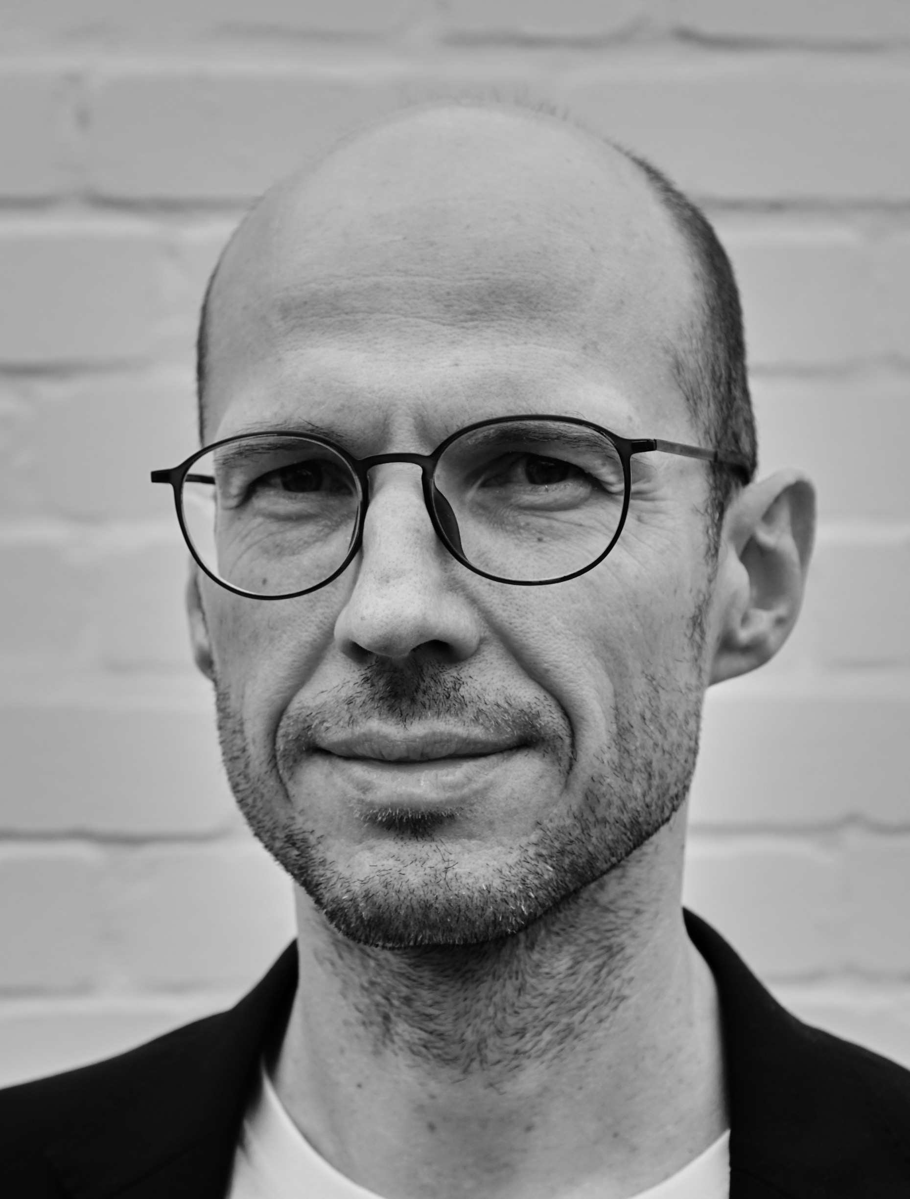
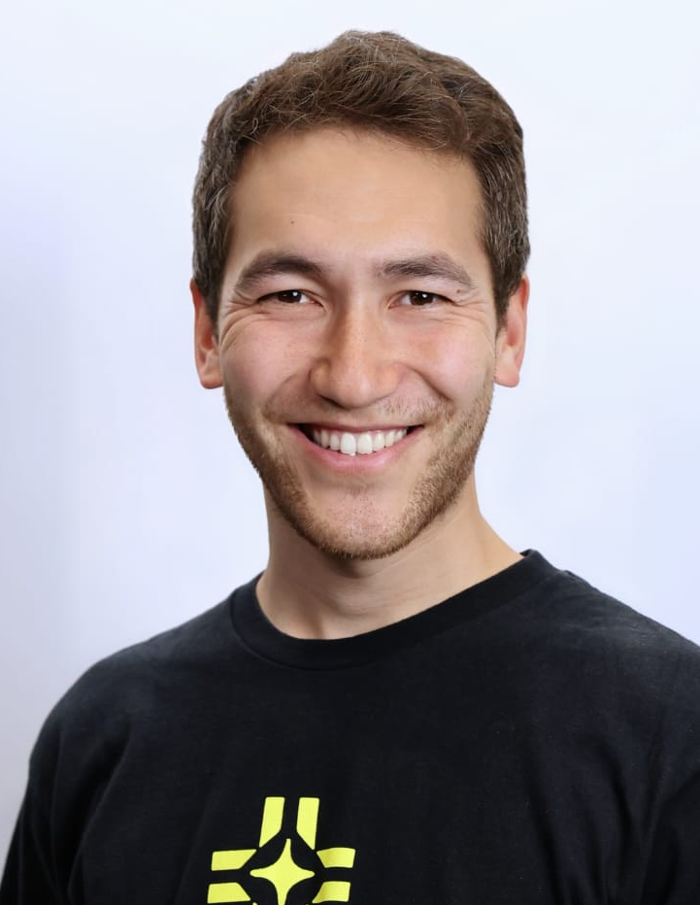
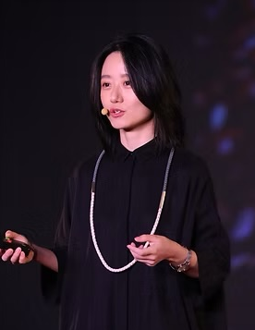
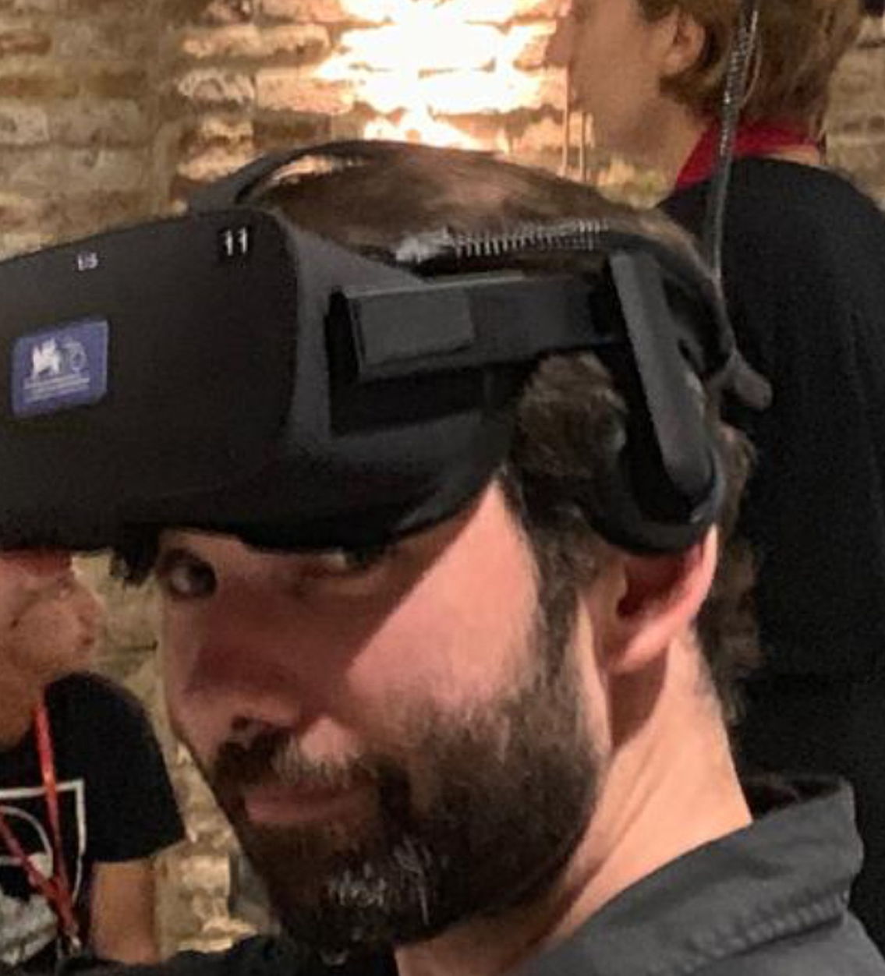
Who will teach you?
Daniel
Schien
Otto
Brookes
Jialin
Deng
Chris
Bevan

Slide 5
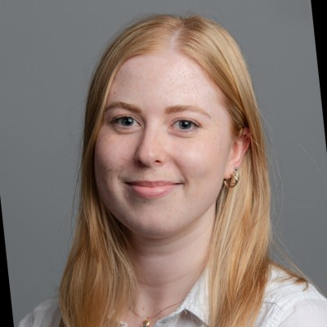
Who else will you see?
Centre for Academic Language and Development
Teaching Technologist Team
Helen Mann
Industrial Liaison Office

Slide 6
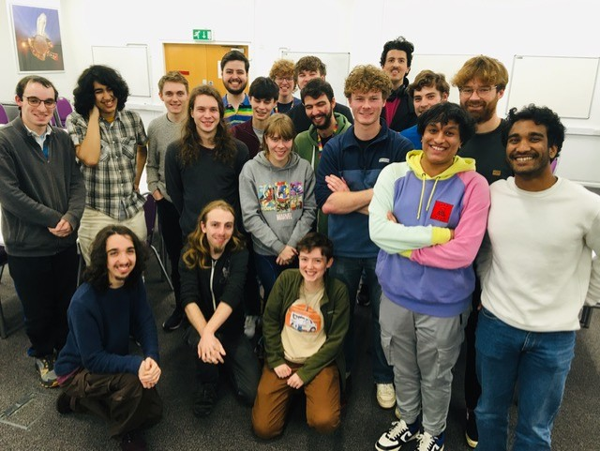
Teaching Assistant Mentors
(your mentors may vary)

Slide 7
What this unit is NOT about
This is NOT just another programming unit
where you get a textual description and just need to “code it up”
It won't be neat and tidy
It won't be straight-forward
There WILL be uncertainty
You WILL make mistakes – and that’s ok!
YOU will have to "go find out"
These are all key elements of the unit!
Notes:
Dan

Slide 8
What this unit is NOT about
This is NOT just another programming unit!
SEP is NOT just about the end product
In other units, you can succeed by "somehow”
building a working system
In SPE, we care about the process, just as much as the product
Remember: It's about the journey just as much as the destination
Notes:
Dan

Slide 9
What this unit is NOT about
This is NOT just another typical undergraduate unit
where you passively "observe" lectures all term
then madly cram for an exam or CW right at the end
This is a slow-burn, long-game unit
You'll need to put in constant effort for the whole of the year
There should be no manic push to finish at the end
(If you work correctly) You'll just stop when the time runs out
Notes:
Dan

Slide 10
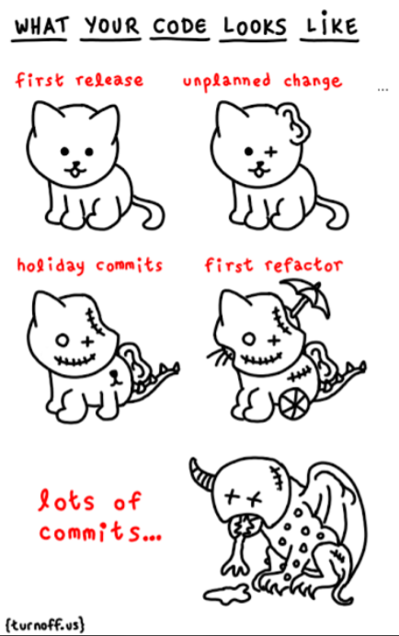
Your code currently be like…
“Managed and repeatable engineering of complex systems ?”
Notes:
Dan

Slide 11
Authentic learning
Work as part of an integrated development team
To build a real-world software system
Of significant size and complexity
For a real client organisation with real business needs:
  Public sector organisations
  Small and Large Businesses
  Charities & Social Enterprise
  University of Bristol
  Individuals/self-employed people
Notes:
Dan

Slide 12
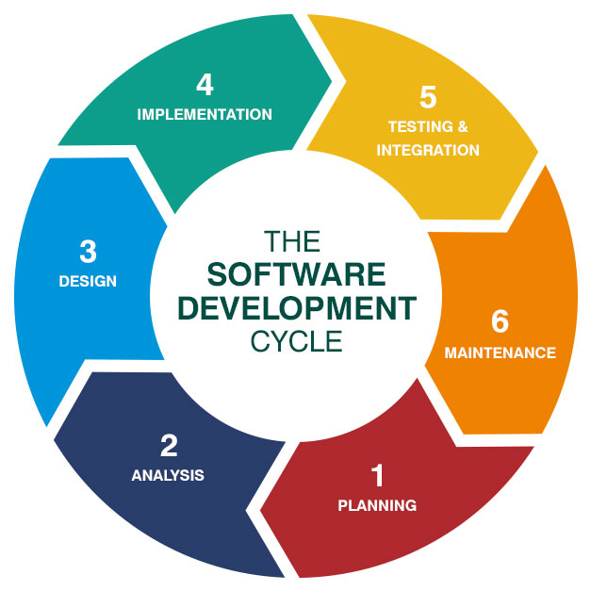
Notes:
Ruzanna

Slide 13
How are you marked?

Slide 14
Individual Learning Outcomes
Develop a software system of significant scale within a mature and repeatable Software Development process and apply Agile Principles & Practices.
Select and employ development support tools (as appropriate to the project being undertaken).
Work effectively within real-world development contexts and with clients.
Collaborate effectively within small teams.
Apply basic principles of project management and identify the presence of (and employ techniques to mitigate the impact of) project uncertainty and risk.
Notes:
Sarah

Slide 15
Assessed elements
The quality and maturity of your development process
Meeting release deadlines and milestones
Team dynamics and relationship with client
"Viva" style presentation and discussion
Product demonstration
Notes:
Sarah

Slide 16
Handing over code to your clients
You MUST give at least 3 releases to your client:
Minimum Viable Product (MVP) (20 November – Week 9)
Beta Release (19 February – Week 17)
Final release (30 April – Week 24)
You can release more! These are the last possible dates!
Notes:
Sarah

Slide 17
Assessed Elements - metrics
Group mark: presentation and product demo (the viva) in summer exam period – this gives the overall group mark.
Marks are then individualised using
Peer review
Mentor reports
Github metrics analysed and interpreted
  Kanban board issues
  Number of commits
  Pull requests
  Test cases
IF IT’S NOT ON GITHUB, WE CAN’T ASSESS IT!
Notes:
Sarah

Slide 18
Formative feedback
Team Definition in week 10
Practice viva – Week 19 (Beta Release)
4 or 5 teams present to each other
A chance to see other teams’ work
A chance to mark the other teams, to give you an idea of how marking works
Feedback from staff, mentors and peers
Notes:
Sarah

Slide 19
Formative feedback
Weekly feedback based on your repos
Top 10 teams are shared, so you can get inspiration from their repos
Weekly feedback, so you can see what needs to improve
Some teams won’t be able to do everything that’s ranked straight away – and that’s ok
These are NOT your final marks!
These are NOT the same GitHub metrics we use to mark!
These are to give you continual feedback on your project and help you improve
Notes:
Sarah

Slide 20
Formative feedback
If the team goes off track
Meetings with the unit staff
If you want more
Come to the weekly drop-ins and ask!
Notes:
Sarah

Slide 21
Team Agreement
Define ways of working
Initiate in wk 2
Develop throughout
Present Team Definition in week 10
Track in Github, evidence for marking

Slide 22
Team Effort
Groups can include people with high Firsts and fails
An individual cannot out-perform the team envelop and get a better grade
But they can under-perform and get a worse one!
Your individual grade will be determined by your contribution to the group
You MUST leave a paper-trail on the collaboration systems (we need evidence!)
There will also be a peer-review process
Individuals WILL have the "opportunity" to resit over the summer
Notes:
Sarah

Slide 23
Team Effort
This project is a team effort - you MUST all work together
The group mark will be determined by the output of the entire team
Everyone in the group MUST contribute to the codebase
You can't complain that the team isn't performing – you are the team!
Notes:
Sarah

Slide 24
How to fail SEP
Don’t show up to meetings!
Don’t do any work!
Don’t commit regularly to GitHub!
This will NOT be a surprise!
If we’re worried about teams/individuals, we WILL tell you!
Notes:
Sarah

Slide 25
You are allowed to make mistakes!
You are not expected to be good at this straight away!
You are marked on the process – if things go wrong, and you learn and grow, tell us in the viva!
You can always re-boot your team processes…
….but don’t expect to get a First if you do no work in TB1!
Notes:
Sarah

Slide 26
Questions?

Slide 27
How will you learn?
Friday 12:00: combined lecture and workshop where you will be expected to work with your team, with staff and TA support.
Thursday 9-13:00 Project Work slots (Wednesday 09:00–13:00 from week 13)
Monday 12:00: optional drop-ins, for individuals or teams (from week 4)
Friday 14:00: tech drop-ins
Notes:
Sarah

Slide 28
How will you learn?
Week 1: Prep for SEP workshop
Week 2: Meet your team and client
… Iterate…
Week 15: User testing day
Week 23: SEP client celebration event
Notes:
Sarah

Slide 29
How will you learn?
SEP is mostly self-directed – you should schedule:
Weekly meetings with mentors
Regular meetings with clients (for you to schedule)
Working as a team (face-to-face)
"Reserved" Thur morning (09:00-13:00)
Video calls on Teams
Notes:
Sarah

Slide 30
What does ‘self-directed’ mean?
You choose your tech stack – we’ll help you with this in Week 3
You can choose libraries / frameworks as appropriate
You learn technologies you don’t know
For web UIs you will have to use HTML/JS/CSS
AWS cloud infrastructure
You should expect to start coding in Week 3
Notes:
Sarah

Slide 31
What does ‘self-directed’ mean?
We expect you to learn together
Face-to-face meetings
Pair programming
Stronger students supporting team mates (this helps your marks!)
Notes:
Sarah

Slide 32
What does ‘self-directed’ mean?
We expect you to support each other
Be kind to each other
Appreciate you all have different strengths and experiences
This is practice for when you are working
Notes:
Sarah

Slide 33
What resources will you have?
Workbooks
We will set up your repos for you
Access to previous years’ repos
GitHub for project management – you MUST use the kanban board!
IF YOUR WORK IS NOT ON GITHUB, WE CAN’T MARK IT!
Support from the staff and from the mentors
Notes:
Sarah

Slide 34
Who are the mentors?
Staff are CEOs of a large development company
We are managing ~40 projects
We’ve drafted in mentors as “middle management”
  Not technical support, but for monitoring and guidance
  Meet with them every week in term time
  They give you repo feedback
  You come ready to give them progress updates and ask questions
  Gather feedback to pass back to Jialin, Dan and Otto
Notes:
Sarah

Slide 35
Who are the mentors?
Your mentors are Year 3 and 4 students
They all took this unit in Year 2
They were all really strong in this unit and/or the Year 3 Teams Project
They are your ‘critical friend’ – they will support you and help you learn
They will tell you if they see problems
They can’t do your code for you!
They are in Year 3 and 4 – please respect their time!
Notes:
Sarah

Slide 36
AI Policy
https://github.com/spe-uob/SEP2026/tree/master/Weekly%20Workbooks/01%20AI%20Tools%20-%20unit%20policy
AI use is allowed but discouraged until TB2

Slide 37
Questions?

Slide 38
How do we decide the teams?
There are various different approaches to forming teams
None of which are particularly satisfying :o(
We’ve found the best way is to let students cluster around projects
We will publish a list of project descriptions
You can browse through them and indicate your preferences
We will then form everyone into appropriate groups...
Math&CS: Decide until Thursday if you want to join this unit or not
Notes:
Dan

Slide 39
The Projects
Teams are usually 5 to 6 students
More than 1 team may work on a project
There are around 60 projects available this year
You will get a list on Blackboard (look out for Teams message/email)
Take your time to look through these descriptions carefully
Notes:
Sarah

Slide 40
Choosing Projects
Project descriptions include some info about who they might suit – consider this carefully!
If you weren’t good at Algorithms, don’t pick the algorithms project!
Don’t be scared of ambitious projects – this is taken into account in the marking. But if you are worried you’ll struggle with this unit, you might not want to pick those.
Choose 5 projects, in order of preference
Notes:
Sarah

Slide 41
Forming Groups
In true spirt of Comp. Sci. we’ll use an algorithm to define groupings:
A "shuffling" algorithm generates a large number of valid configurations
Each configuration is scored on how well it fulfils students' preferences
We then select "best" (highest scoring) configuration from those generated
The aim is to try to achieve "pareto optimality" (or as near as we can get)
The maximum possible combined community score (the greater good!)
There is no guarantee of being allocated one of your chosen projects
Consider the worst-case scenario – you choose projects that no one else likes!
Notes:
Saarh

Slide 42
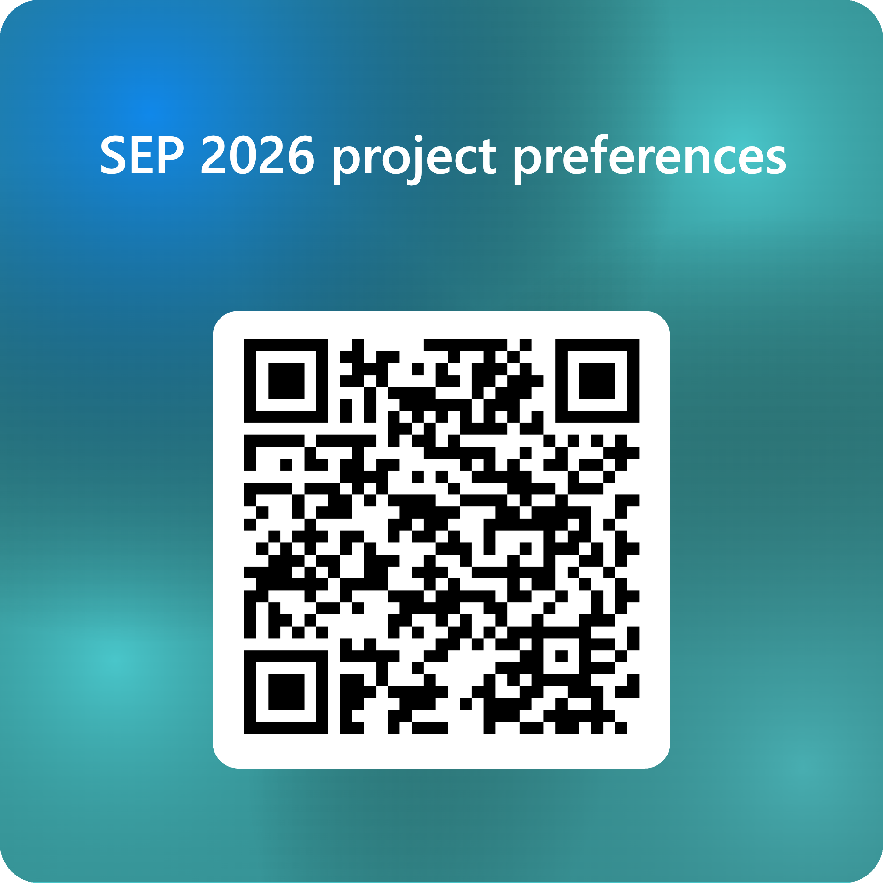
Choosing Projects
The Projects list will be released TODAY on Blackboard:
  https://www.ole.bris.ac.uk/ultra/courses/_269191_1/document/_10337805_1?view=content&state=view
You must have a GitHub Education account when you submit. Register with your UoB email and ideally have your name in the GitHub ID
Choose 3 in order of preference
HARD DEADLINE: 15:30 on Friday 26 September
Notes:
Sarah

Slide 43
Choosing Projects
You can't edit your selection after submitting: so choose carefully!!!
Make sure you DO submit – or we will choose for you
You can’t choose the same project multiple times – if you do, we will ignore that project
Questions about Projects? Ask in the Unit Team Q&A channel – tag Jialin and Amy Jose!
Friday’s drop-in, 14:00-15:00 for last-minute questions
Notes:
Sarah

Slide 44
Questions?

Slide 45
Dates – next two weeks

Slide 46
Some tips!
Don’t stop work when the Computer Systems A coursework starts!
NEVER SPEND ANY MONEY ON SEP!!!!
Notes:
Sarah

Slide 47
Questions?

